Slide 1
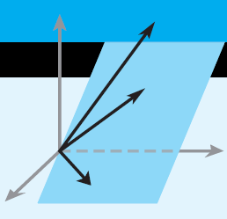
Elementary Linear Algebra
Chapter 7
Notes:
*

Slide 2
Chapter 7
7.1 Orthogonal Matrices
7.2 Orthogonal Diagonalization
7.3 Quadratic Forms
7.5 Hermitian, Unitary Matrices
Notes:
*

Slide 3
7.1 Orthogonal Matrices
Notes:
*

Slide 4
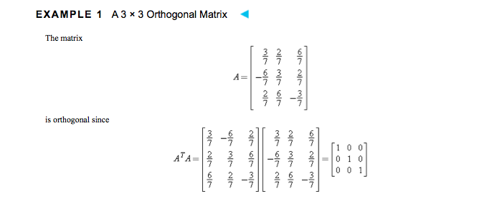

Slide 5
Notes:
*

Slide 6
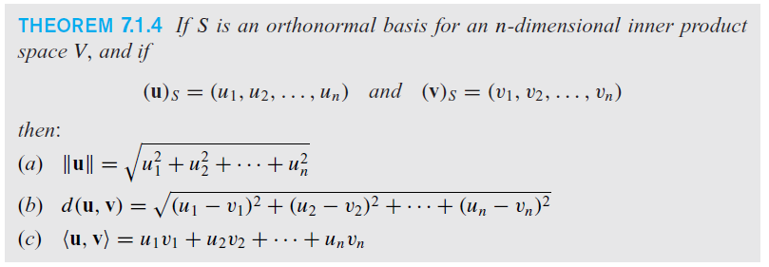
Orthonormal Basis
Notes:
*

Slide 7
Orthogonal Diagonalization
Notes:
*

Slide 8
Symmetric Matrices
Notes:
*

Slide 9
7.3 Quadratic Forms

Slide 10
Definite quadratic forms
Notes:
*

Slide 11
Section 7.5 Hermitian, Unitary and Normal Matrices
Notes:
*

Slide 12
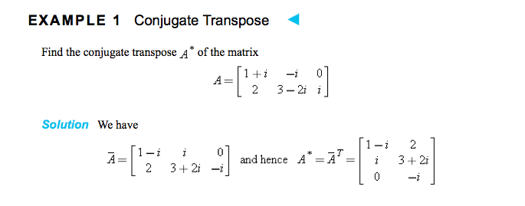

Slide 13
Hermitian Matrices
Notes:
*

Slide 15
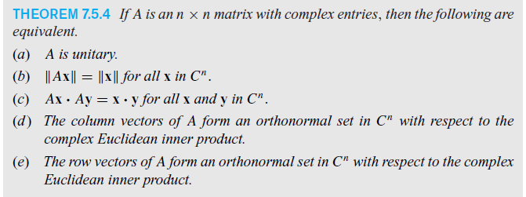
Unitary Matrices
Notes:
*

